Slide 1
Pathogen-informed strategies for sustainable broad-spectrum crop resistance (SUSTAIN)
FA1208
Start date: 19/04/2013
End date: 18/04/2017
Year: 1
Thomas Kroj
INRA (National Agronomic Research Institute) FRANCE

Slide 2
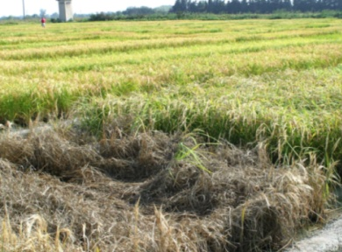
Scientific context and objectives (1/2)
Background / Problem statement:
Plant diseases are a major problem
in agriculture.
Disease resistant crop varieties constitute
the economically and ecologically most viable
alternative to pesticides in plant pest control.
Rapid breakdown of resistance and restricted
resistance gene reservoirs limit the agronomic value of genetic crop resistance

Slide 3
Scientific context and objectives
pathogen
effector
effector
AVR
effector
effector
effector
effector
effector
effector
effector
R proteins
plant
proteins
Immune receptor
cellular processes
defence
Resistance
metabolism
physiology
development
Disease

Slide 4
Scientific context and objectives (2/2)
Disease development is an active, pathogen-controlled process mediated by secreted pathogen proteins called Effectors
The massive sequencing of pathogen and plant genomes and the advance of effector biology produced tremendous progress in Plant Pathology
The understanding of the molecular and evolutionary mechanisms of pathogen virulence enables knowledge-based breeding and engineering for durable crop resistance
    - Identification of new resistance traits and loci in plant germplasm collections.
    - Evaluation of resistance durability by detailed analysis of pathogen effector.
MoU objectives:
Transfer of knowledge on plant resistance, effector function and effector evolution from academic research to plant breeders.
Build a platform for the development of durably resistant cereal and solanacous crops for Europe and developing countries.

Slide 5
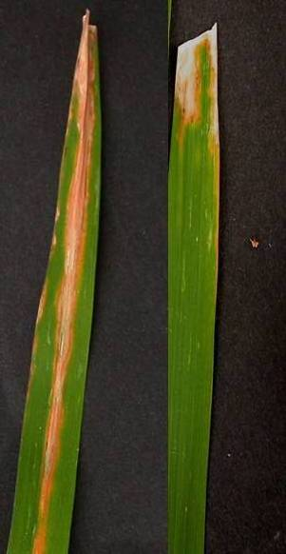
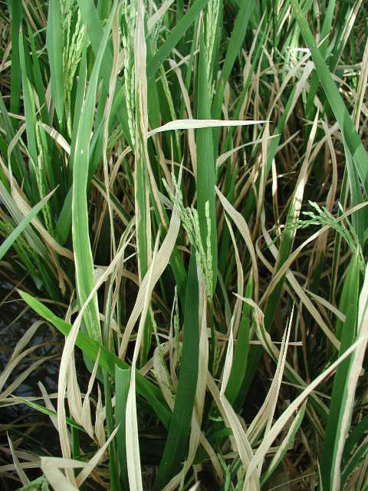
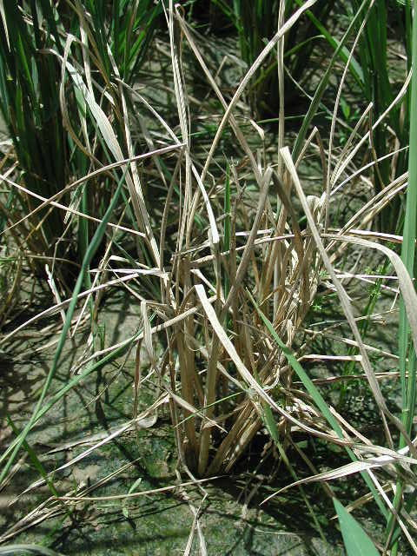
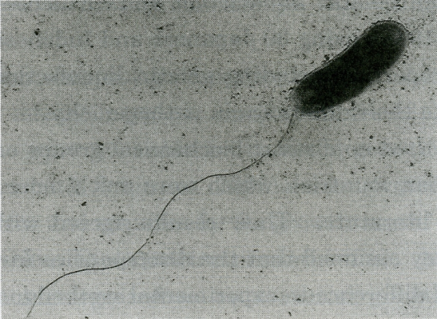
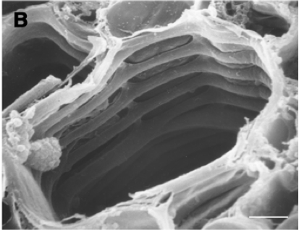
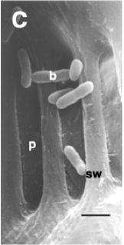
Bacterial Leaf Blight (BLB) of rice
Causal agent : Xanthomonas oryzae pv. oryzae (Xoo)
Host : Oryza spp.
Vascular and systemic disease
Important yield loss
Hilaire et al., 2001

Slide 6
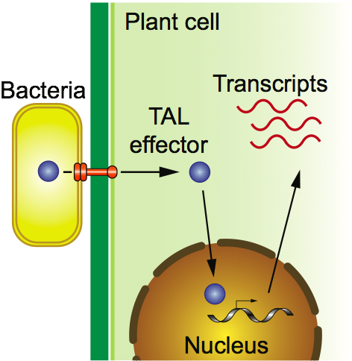
TAL (Transcription Activator-Like) type III effectors
Boch and Bonas, 2010, Annual review of phytopathology
Notes:
6

Slide 7
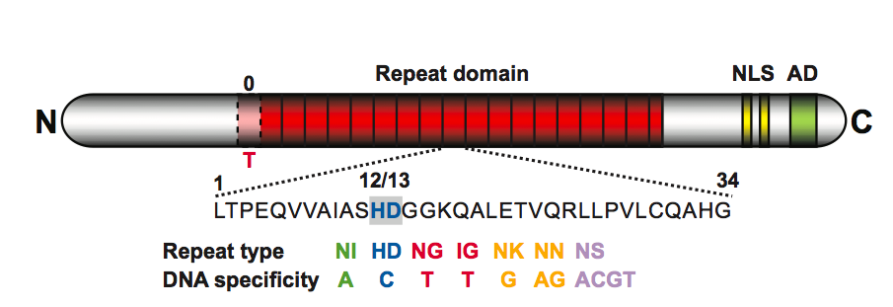
TAL (Transcription Activator-Like) type III effectors
Boch et al., 2009 ; Science
Boch and Bonas, 2010, Annual review of phytopathology
Notes:
7
Conservée chez xantho
Certains sont des facteurs de virulence majeurs.

Slide 8
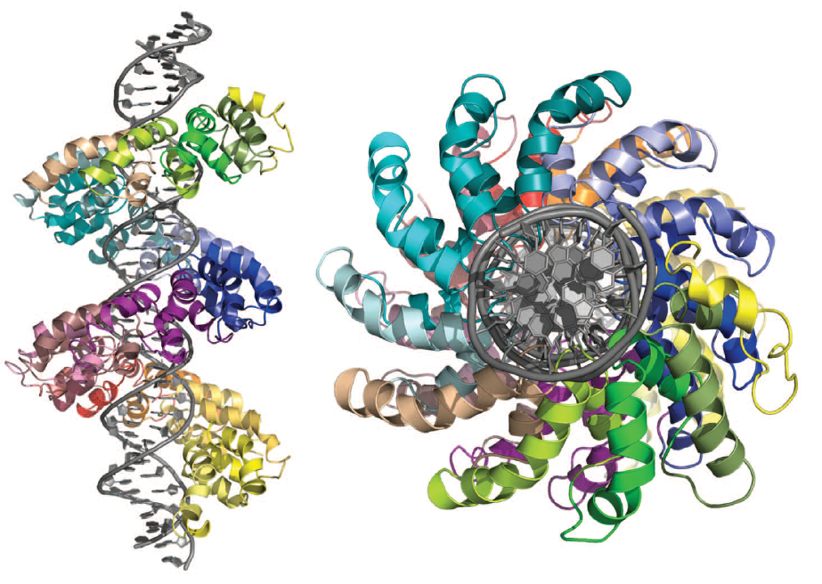
TAL (Transcription Activator-Like) type III effectors
Boch et al., 2009 ; Science
Boch and Bonas, 2010, Annual review of phytopathology
Mak et al., 2012, Science
Notes:
8
Conservée chez xantho
Certains sont des facteurs de virulence majeurs.

Slide 9
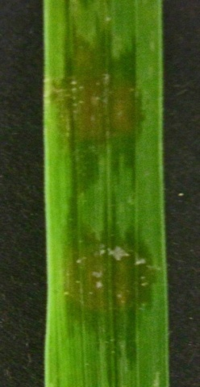
Roles of TAL effectors in plant disease
TAL effector
Susceptible plant
Susceptibility gene
TAL box

Slide 10
SWEET14 is targeted by multiple strains…
Mali
Tal5_{MAI1}
Philippines
Burkina Faso
PthXo3_{PXO61}
TalC_{BAI3}
pthXo3
talC
avrXa7
tal5
SWEET14
Susceptibility
AvrXa7_{PXO86}
…of different geographic origins and lineages
B. Szurek, FR
Notes:
Variants allelique ds zone ciblé
R a large spectre

Slide 11
BB resistance by TAL insensitive SWEET14 promoters
Mali
Tal5_{MAI1}
Philippines
Burkina Faso
PthXo3_{PXO61}
TalC_{BAI3}
SWEET14
?
Loss of susceptibility
AvrXa7_{PXO86}
B. Szurek, FR
Notes:
Variants allelique ds zone ciblé
R a large spectre

Slide 12
Working groups
WG1 Pathogen effectors and virulence
WG2 Plant proteins and processes targeted by effectors
WG3 Effector evolution and emergence of new pathotypes
WG4 Plant immune receptors and allelic variants of host targets for resistance breeding

Slide 13
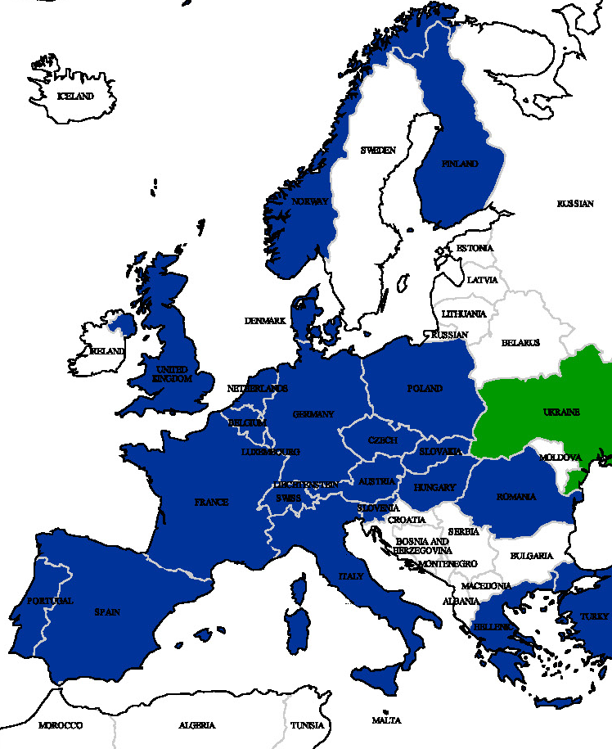
Action Parties
Grant Holder:
INRA-Montpellier,
Thomas KROJ (Chair)/
Laurent BRUCKLER
FRANCE
ISRAEL

Slide 14
Action participants

Slide 15
Use of COST Instruments
Activity (No.) | Year 1 | Year 2 | Year 3 | Year 4
MC/WG Meetings | 1 | 1
STSMs | 8 | 8+
Training Schools | 1 | -
Workshops or Conferences | 2 | 4
Joint Publications | 24 (206)

Slide 16
Results vs. Objectives
    Successful networking of >150 participants from academic research and industry
    New collaborations & joint projects
    8 STSMs
    1 Conference & 1 Workshop
    Training school for dissemination of know-how on cutting edge technologies

Slide 17
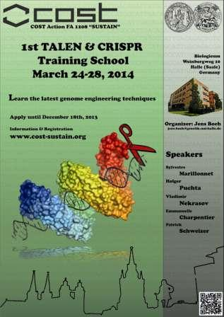
Significant Highlights in Science or Networking
1st TALEN and CRIPR Training School
Dissemination of cutting edge knowledge on novel non-GMO genome editing technologies
17 participants chosen among 38 applications
Presentations by 6 internationally leading experts
Hands-on training, detailed protocols, network of expertise

Slide 18
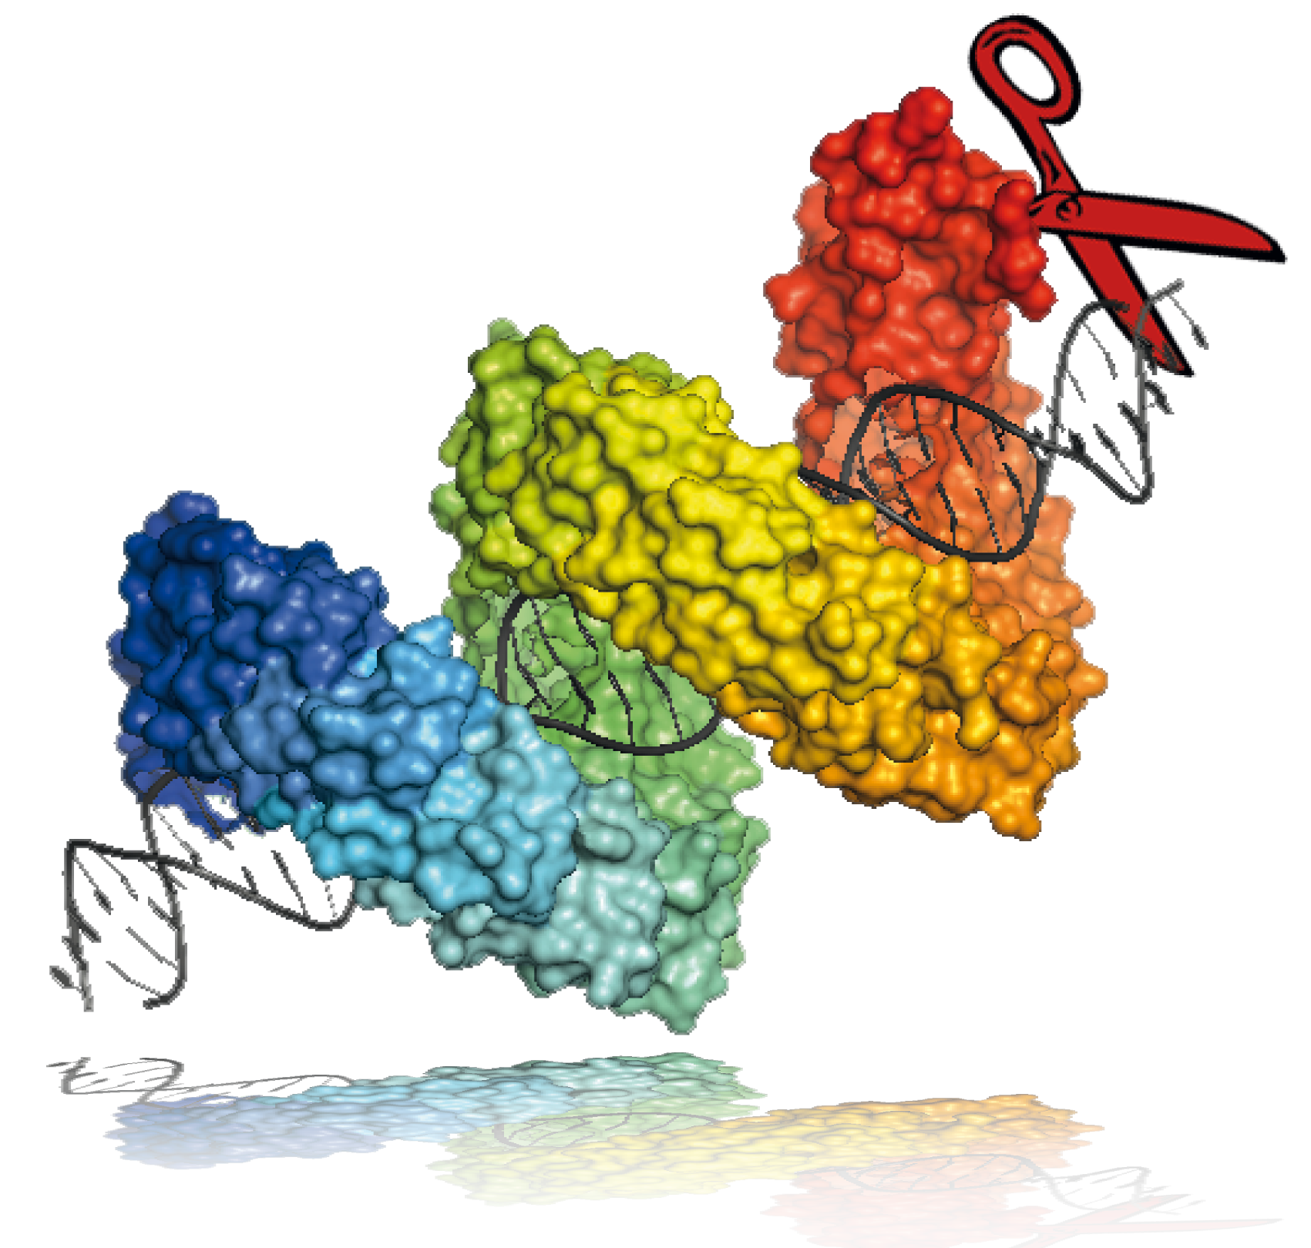
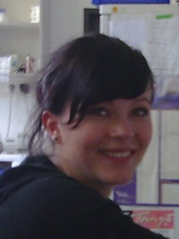
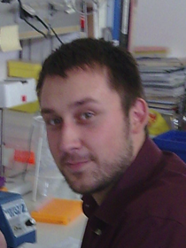
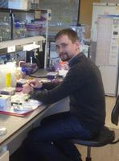
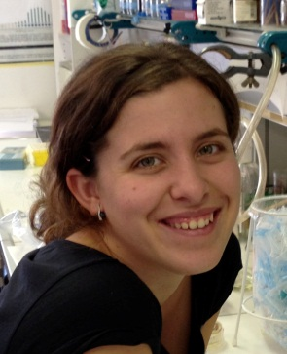
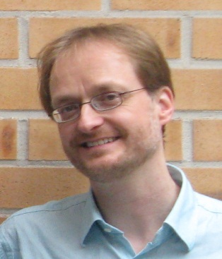
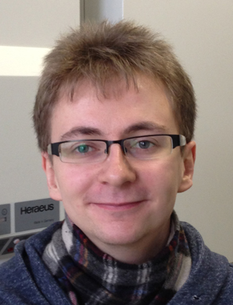
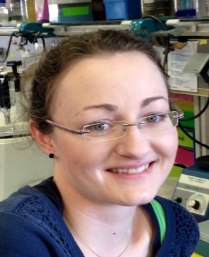




TALEN & CRISPR Training School
Jens Boch
jens.boch@genetik.uni-halle.de
The Local Team
Jana Streubel
Maik Reschke
Dr. Jens Boch
Dr. Vladimir Nekrasov
(group of S. Kamoun)
Dr. Montserrat Solé Castellví
Sebastian Becker
Annekatrin Richter

Slide 19
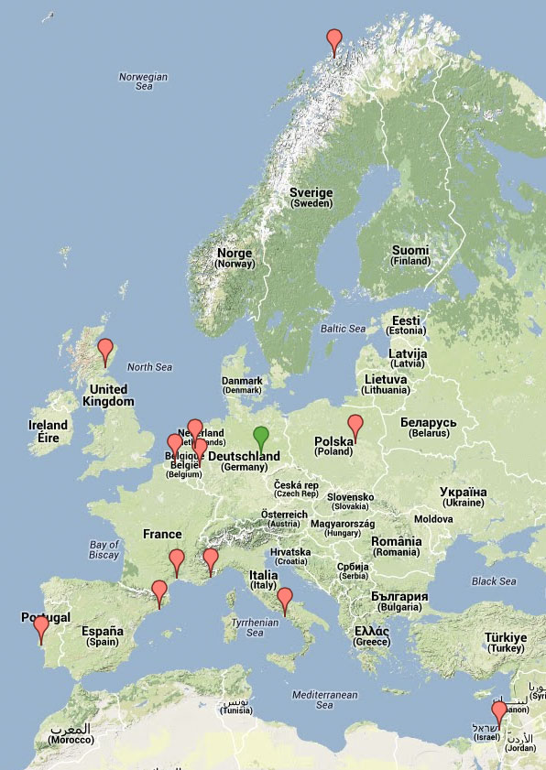

1st TALEN & CRISPR Training School
Participants
17 participants (red label) from 11 countries attended the course in Halle (green label).
Nuno Almeida Portugal
Servane Baufume France
Eran Bosis Israel
Emmanouil Domazakis Netherland
Paolo Iovieno Italy
Stefan Kusch Germany
Tina Kyndt Belgium
Haibin Lu Spain
Sophie Mantelin UK
Hazel McLellan UK
Clemence Medina France
Stian Olsen Norway
Laurens Pauwels Belgium
Waldek Skowron Poland
Weronika Wituszynska Poland
Mireille van Damme Netherlands
Ilse van den Brande Belgium

Slide 20
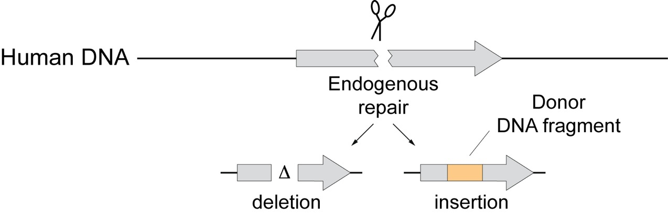

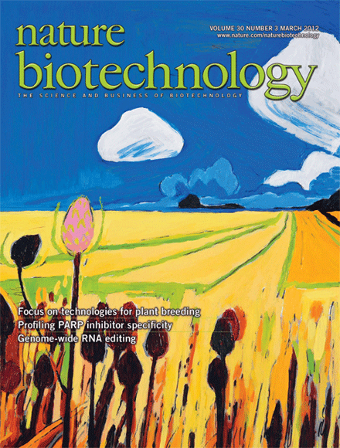
Genome editing
Plant DNA
NHEJ
(non-homologous end joining)
HDR
(homology-directed repair)
Gene therapy
Agbiotech 2.0

Slide 21
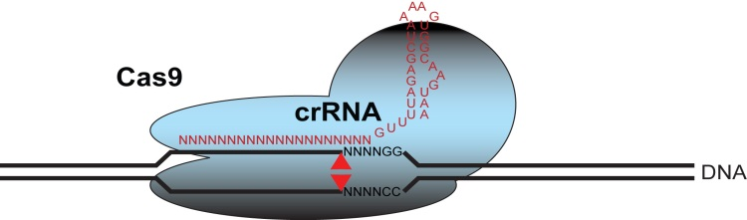
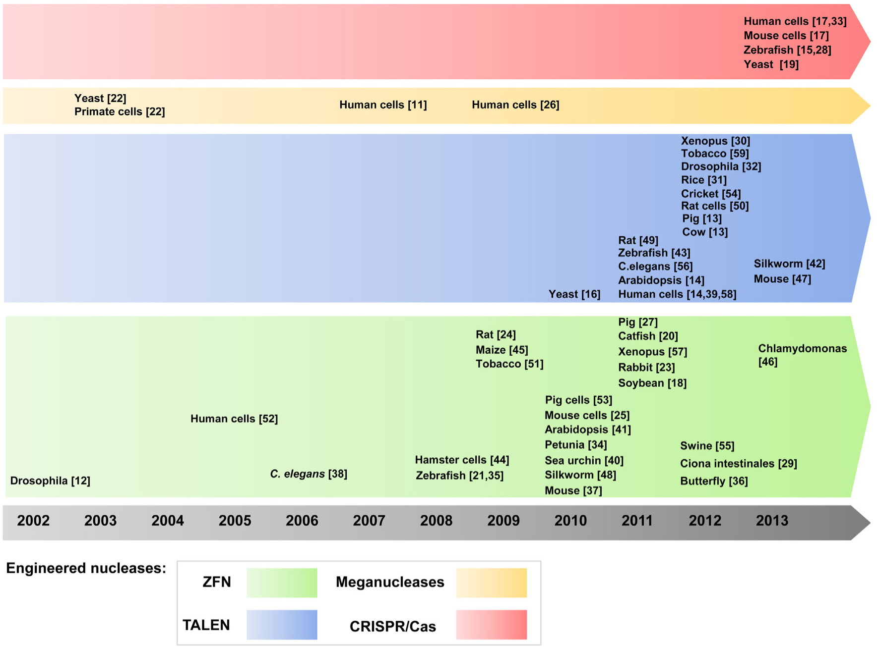
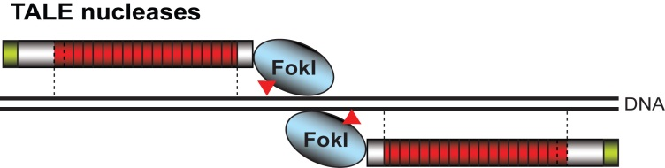
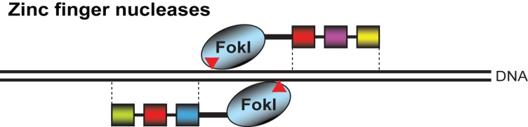
Genome editing timeline
Pauwels et al. (2013) New Biotechnology

Slide 22
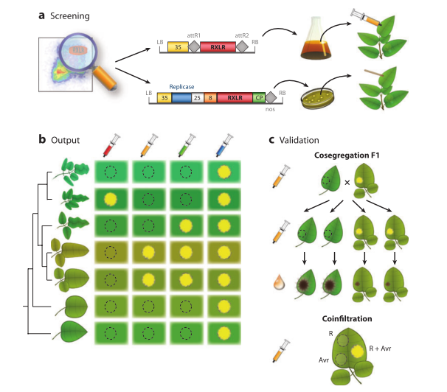
Significant Highlights in Science or Networking
Effector breeding

Slide 23
Significant Highlights in Science or Networking
Effector breeding
Developed by 3 partners of SUSTAIN for potato late blight disease and presented at the 1st annual conference
Simplified and accelerated screening of germplasm
Early evaluation of resistance spectrum and durability
High interest in adaptation to other disease, other solanacous crops and cereals

Slide 24
Challenges
Stronger involvement of industry and breeders
  Breeder Workshop - Effector Breeding, Spring 2015, Wageningen, NL
Extend the network for WG3 and put more emphasis in effector diversity (WS in summer 2015)
Critical Activities
Initiate contact with other projects and organizations such as EPSO, EMBO, EUCARPIA for joint workshops or training schools

