Slide 1
Pathogen-informed strategies for sustainable broad-spectrum crop resistance
SUSTAIN
COST Action FA 1208
Chair Thomas Kroj, INRA, Montpellier, France
Co-Chair Aska Goverse, Wageningen University, The Netherlands
Banyuls, 18th of February 2016

Slide 2
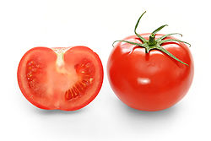
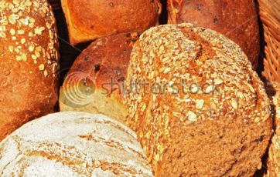
Pathogen-informed strategies for sustainable broad-spectrum crop resistance
COST Action FA 1208
4 year funding 2013-2017 ~150 k€ per year

Slide 3
Tools and Activities
Short term Scientific Missions (STSM)
Meetings and Conferences
Annual Conference
Smaller meetings/Workshops
Workshops/Sessions in Conferences
Training Schools

Slide 4
Short term scientific missions (STSMs)
5 days to 3 months,
44 STSMs funded
STSM Coordinator: Prof. Lieve Gheysen (BE)
STSM Committee for the evaluation of applications:
Chair, Vice-Chair, STSM Coordinator , WG leaders, …

Slide 5
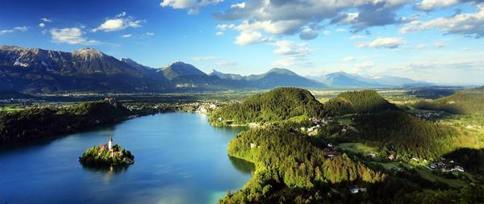
COST-FA1208 STSM
Short Term Scientific Missions 2013-2017
Coordinator: Lieve Gheysen

Slide 6
STSM summary
Short Term Scientific Missions
Opportunities for training of (young) scientists and strengthen collaborations
Related to: scientific objectives of COST action
Who: PhD students, post-docs, researchers, scientific staff
How long: 5 days to 3 months

Slide 7
STSM summary
Short Term Scientific Missions
8 calls, 2 per year, total budget €84,365
Start: December 2013
End of last period: April 2017
December 2013-May 2014
February-May 2014
July-December 2014
January - May 2015
June - Decembre 2015
January - May 2016
June - October 2016
December 2016 - April 2017

Slide 8
STSM approval
Evaluation by the MC, that delegated this to an STSM committee.
Scientific scope must be in line with the Action objectives.
Priority to Early Stage Researchers (ESR, PhD 8Y).
Geographical and gender balance in consideration.
Notes:
ESR = postdoc met max 8 jaar anc

Slide 9
STSM approval
44/69 applications funded, 5 non-ESR
Notes:
Nearly 2/3

Slide 10
STSM approval
Applications funded: 19M 25F
Notes:
Nearly 2/3

Slide 11
44 STSM
Age of the researchers
23 24 25 26 27 28 29 30 31 32 33 34 35 36 37 38 39 40 41 45 59

Slide 12
44 STSM
5 days to 3 months

Slide 13
44 STSM
Maximum 2500 euro

Slide 14
44 STSM
Sending countries (16)
Top 3:
France (9)
UK (6)
Germany (5)
Notes:
France
3 Toulouse, 3 Montpelleir, 1 Versailles, 1 Montfavet, 1 Sophia-Antipolis
UK
3 Dundee, 1 London, 1 Coventry, 1 Cambridge
Germany,
2 Marburg, 1 Halle, 1 Bonn, 1 Hannover

Slide 15
44 STSM
Host countries (11)
Top 3:
UK (16)
France (9)
Germany (5)
Notes:
UK
6 to Norwich, 6 to Dundee, 2 to London, 1 Oxford, 1 Edinburgh
France
4 INRA Toulouse, 2 Sophia Antipolis, 1 marseille, 1 Paris, 1 Montpellier
Germany
2 Halle, 1 Gettingen, 1 Cologne, 1 Aachen

Slide 16
STSM
Results: publications
Notes:
Amey from MPI Marburg to Warschaw 1st call
(Rafal from Warschaw to Halle for bacterial effector)
Thierry Marcel from INRA Versailles to ETH Zurich

Slide 17
Thank you
STSM committee
(Aska Goverse, John Jones, Beat Keller, Nemo Peeters, Eva H. Stukenbrock, Didier Tharreau, Bart Thomma, Hans Thordal-Christensen, Vivianne Vleeshouwers)
Thomas Kroj
Claire Nieuwenhuis
Audrey Canado

Slide 18
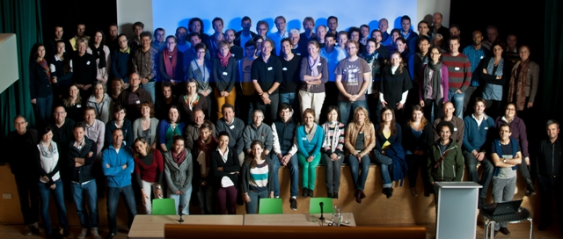
Annual Conferences
October 2013 in Birnam, UK
John Jones (James Hutton Institute)
October 2014 in Zakopane, Poland
Magda Krzymowska (Polish Academy of Sciences) & Marcin Filipecki (Warsaw University of Life Sciences)
February 2016 in Banyuls, France
Nemo Peeters (INRA-Toulouse) and Thomas Kroj (INRA-Montpellier)
February 2017 in Bled, Slovenia
Sasa Sirca and Barbara Geric-Stare (Agricultural Institute of Slovenia)

Slide 19
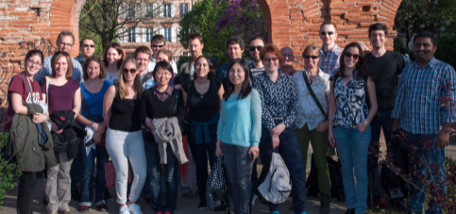
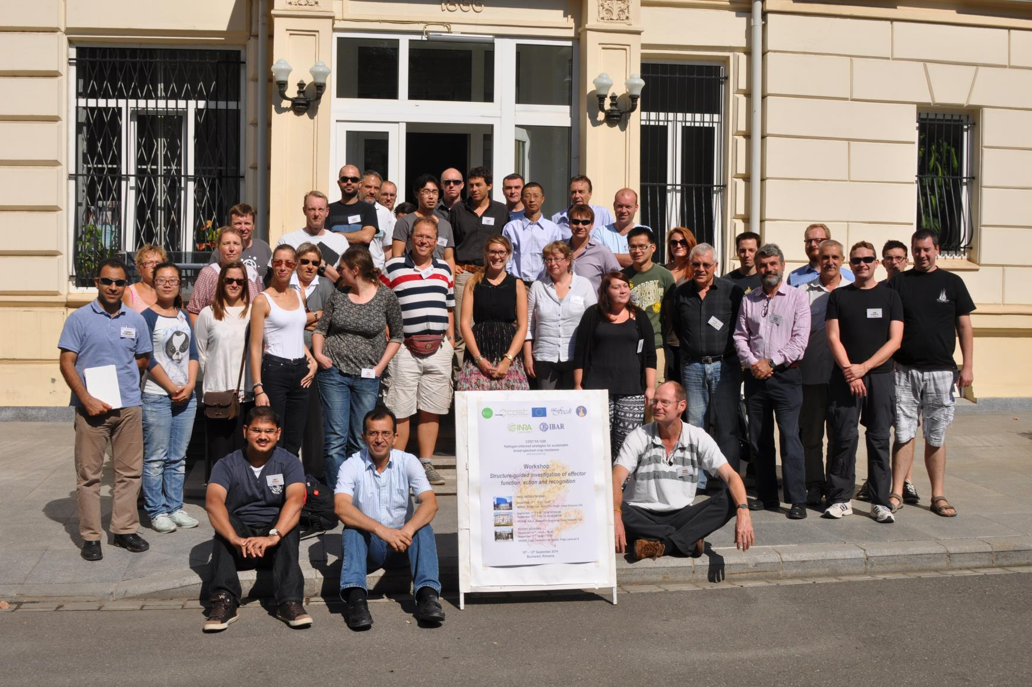
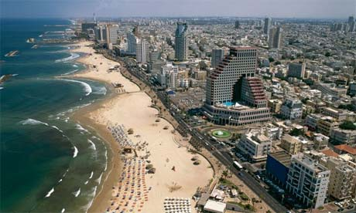
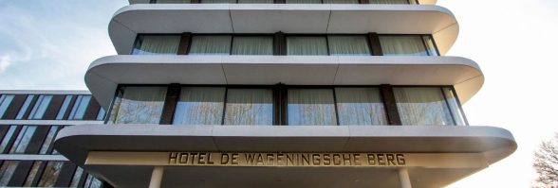
Workshops
Cellular dynamics of effector action and recognition
April 2014, Toulouse, France
Nemo Peeters (INRA-LIPM)
Structure-guided investigation of effector function, action and recognition
September 2014, Bucharest, Romania
Andrei Petrescu, IBAR (Romanian Academy of Science)
Experimental approaches for the investigation of effector function
February 2015 in Tel Aviv, Israel;
Guido Sessa (Tel Aviv University)
Breeder Workshop
April 2015 in Wageningen, The Netherlands
Aska Goverse, Vivianne Vleeshouvers, Bart Thomma, Suzan Gabriels
(Wageningen University, Monsanto)
Evolutionary genomics of plant pathogens
August 2015 in Kiel/Germany
Eva H. Stukenbrock, Michael Habig (University Kiel, MPI)

Slide 20
Sessions in Conferences
6th International Bacterial Wilt Symposium, 3-7 July 2016, Toulouse, France

Slide 21
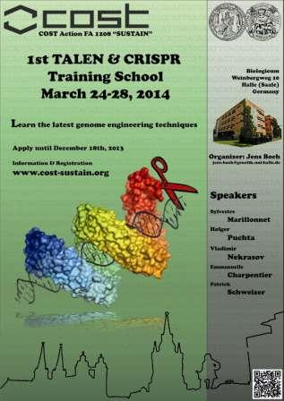
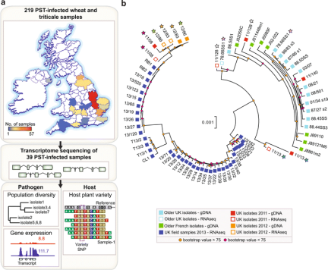
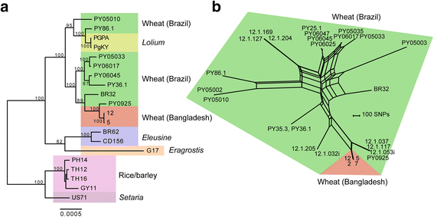
TALEN and CRIPR Training School
March 2014 in Halle, Germany
Jens BOCH (University Halle)
Pathogenomics Training School
April 2017 in Norwich, UK
Eva Stukenbrock (University Kiel) & Sophien Kamoun (The Sainsbury Laboratory)

Slide 22
Reporting
31/10/2015 30 month Scientific Report
22/05/2017 Final assessment
Action achievements against the objectives and potential impact
I Progress
MoU objectives
MoU deliverables
Joint grant applications / joint papers
II Impacts
- careers, skills and network of researchers, including ECIs (for example: joint supervision of graduate and PhD students, research exchanges not funded by the Action, collaborations, Training Schools with ECTS accreditation, joint projects, internship and job prospects).
- short- to long-term scientific, technological, and / or socioeconomic changes produced by a COST Action, directly or indirectly, intended or unintended
III Dissemination and exploitation of Action results
Outreach to the general public and to farmers. Important that the general public are made aware of such
important activities.
IV Success stories

Slide 23
Final Dissemination
Series of Opinion Papers in Molecular Plant Pathology
3000 words, opinion not review, 10 references
Deadline: March 18th for topics and authors, end of May for the manuscript
acknowledge support by COST grant FA1208!, i.e. joint publications between groups of SUSTAIN and STSMs

Slide 24
Final Dissemination
Series of Opinion Papers in Molecular Plant Pathology
3000 words, opinion not review, 10 references
Deadline: March 18th for topics and authors, end of May for the manuscript
Success story
For communication to the Comission
your input is appreciated
acknowledge support by COST grant FA1208!, i.e. joint publications between groups of SUSTAIN and STSMs

Slide 25
Future of the Network
COST Action on Xanthomonas and Xylella
CA COST Action CA16107 EuroXanth: Integrating science on Xanthomonadaceae for integrated plant disease management in Europe
Parts of the network formed consortia on different projects
Future depends on the need and initiatives of the network

