Slide 1
Pathogen-informed strategies for sustainable broad-spectrum crop resistance
SUSTAIN
COST Action FA 1208
Chair Thomas Kroj, INRA, Montpellier, France
Co-Chair Aska Goverse, Wageningen University, The Netherlands
Banyuls, 18th of February 2016

Slide 2
Pathogen-informed strategies for sustainable broad-spectrum crop resistance
COST Action FA 1208
4 year funding 2013-2017 ~150k€ + X per year

Slide 3
Tools and Activities
Short term Scientific Missions (STSM)
Meetings and Conferences
Annual Conference
Smaller meetings/Workshops
Workshops/Sessions in Conferences
Training Schools

Slide 4
Tools and Activities
}
Meetings and Conferences
Annual Conference
Smaller meetings/Workshops
Workshops/Sessions in Conferences
Training Schools
Initiatives from the WGs (participants)
Approval by the MC
Local organizer
Eventually combined with other initiatives

Slide 5
Short term scientific missions (STSMs)
5 days to 3 months,
Grant of max 2500 € for exchange between labs form 2 SUSTAIN countries (500€ for travelling + daily allowance, no money for experiments!)
2 calls/year (October/May)
6-8 STSMs/call
Until now 31 STSMs funded
2015/16 28 k€ for 16 STSMs
Decide on Budget for 2016/17
STSM Coordinator: Prof. Lieve Gheysen (BE)
STSM Committee for the evaluation of applications:
Chair, Vice-Chair, STSM Coordinator , WG leaders, …
report compulsory! Acknowledge support by COST grant FA1208!
Applications of early stage researchers will be encouraged!
6th call: March 2016,
STSMs May to November!

Slide 6
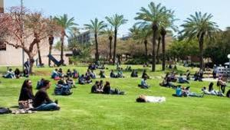
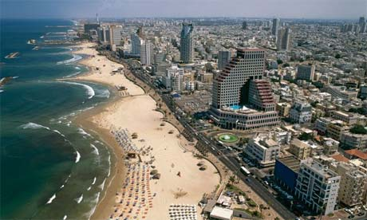
Experimental approaches for the investigation of effector function
10th to the 12th February 2015 in Tel Aviv, Israel.
Guido Sessa, Tel Aviv University
- Protein-protein interaction analysis - PTI/ETI suppression by pathogen effectors - Identification of non-immunity related virulence targets - Innovative strategies to identify effector functions and targets

Slide 7
Breeder Workshop 8-10 April 2015, Wageningen, NL
Aska Goverse Wageningen University
Vivianne Vleeshouvers
Bart Thomma
Suzan Gabriels Monsanto
-Effector-breeding: promises and examples of R gene discovery
-Effector diversity: intraspecific variation, diagnostics and virulence (Avr)
-Common host targets: leads to breed for broad spectrum resistance?
-Host susceptibility: application of S genes to obtain durable resistance?

Slide 8
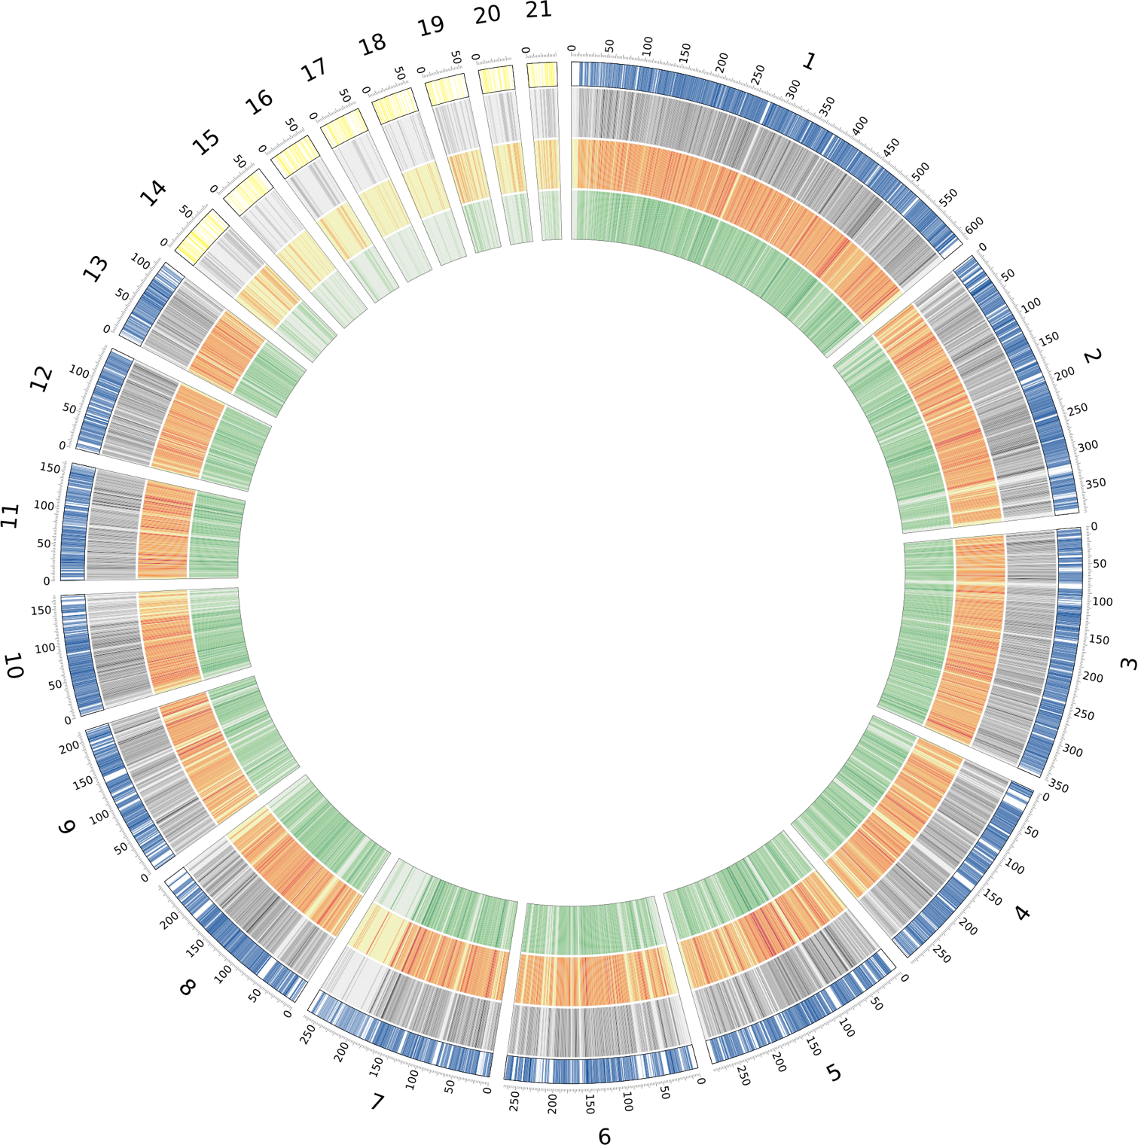
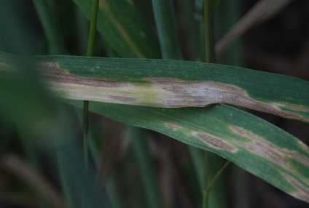
Evolutionary genomics of plant pathogens
– Kiel University, Germany, 26-28 August 2015
Host:
Eva H. Stukenbrock & Michael Habig
Environmental Genomics
Botanical Institute CAU and
Max Planck Institute for Evolutionary Biology

Slide 10
2013, 2014 Annual Progress Conference / feedback from DC
New evaluation procedure, dissolution of domain commitees
30 month Scientific Report 31/10/2015
Final assessment
how well the Action has reached its defined objectives and goals,
immediate, mid-term and envisaged long-term impacts of the Action after its completion, including the initiation of any follow-up activities and its impact on R&D activities in the area covered by the Action.
The COST Action final assessment exercise aims at assessing the Action achievements against the objectives and potential impact
Timeline:
- March 2016 Action Work Plan – budget and organization for:
Annual Conference & Smaller Meetings
Training Schools
STSMs
Publications and Dissemination
Other Outputs
- September 2016 – preparation of final report
acknowledge support by COST grant FA1208!, i.e. joint publications between groups of SUSTAIN and STSMs

Slide 11
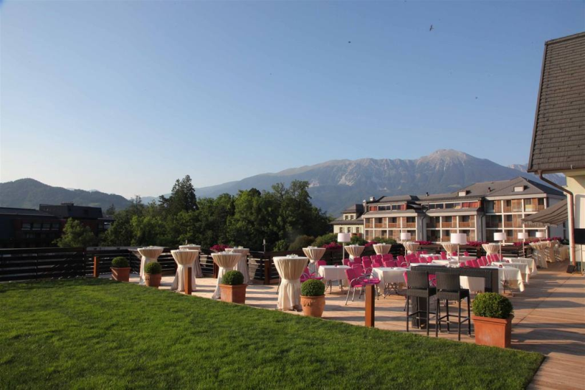
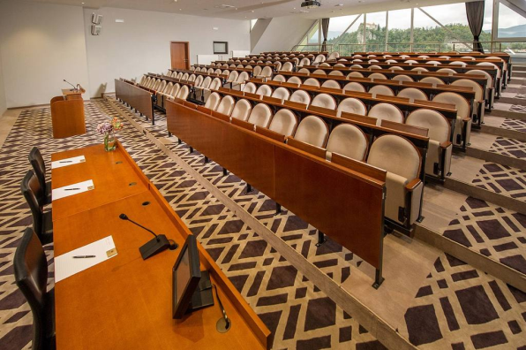
4th Annual Conference of COST SUSTAIN Action FA1208 - 1-3 March 2017 in Bled/Slovenia
Saša Širca & Barbara Gerič Stare, Agricultural Institute of Slovenia, Ljubljana, SI
- well-connected to the International Airport Ljubljana,
- accomodation + meals + breaks 330 – 350€ per person
- venue 1100 €
x
30 km from Ljubljana airport

Slide 12
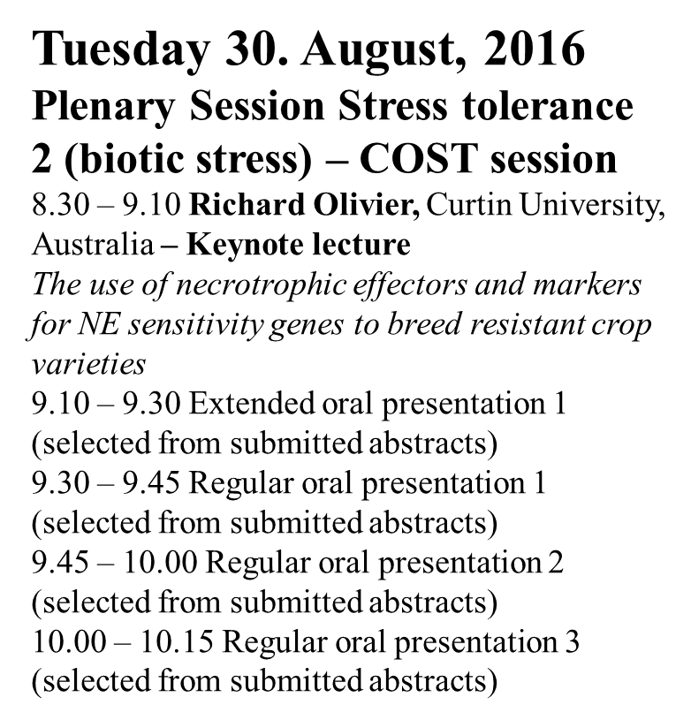
Sessions in Conferences
5 speakers - < 3000 €

Slide 13
Topics for future Small Meetings & Training Schools
-Genomics of effectors (SM or TS)
-Identification of effector genes by analyses of RNAseq data (TS)
-Cellular dynamics of effector action and recognition (SM)
-Functional Analysis of Effectors - transient assays, heterologous systems, molecular and cellular biology (TS,SM) .
-Structure-guided investigation of Effector function and Effector recognition (SM).
-Industry/breeder workshops on pathogen-informed resistance breeding, engineering and monitoring (2xSM).

Slide 14
Tools and Activities
Training School
- 3-15 days
15 – 25 trainees
8 trainers
Pathogen Genomics" or "Plant & Pathogen Genomics"

