Slide 1
Pathogen-informed strategies for sustainable broad-spectrum crop resistance
SUSTAIN
COST Action FA 1208
Chair Thomas Kroj, INRA, Montpellier, France
Co-Chair Aska Goverse, Wageningen University, The Netherlands
Birnam , 10th of October 2013

Slide 2
Introduction on the COST Action SUSTAIN
Background and History
Goals and Objectives
Network and Organisation
Instruments and Activities

Slide 3
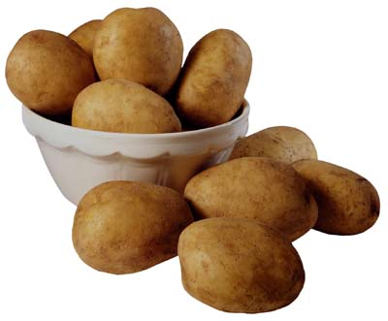
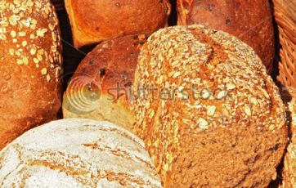
Pathogen-informed strategies for sustainable broad-spectrum crop resistance
COST Action FA 1208
Main objective:
Innovative pathogen-informed strategies to obtain sustainable and broad spectrum resistant varieties of cereal and solanaceous crops
4 year funding 2013-2017 ~140k€ per year

Slide 4
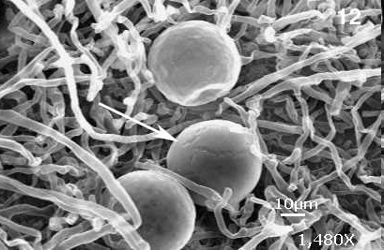
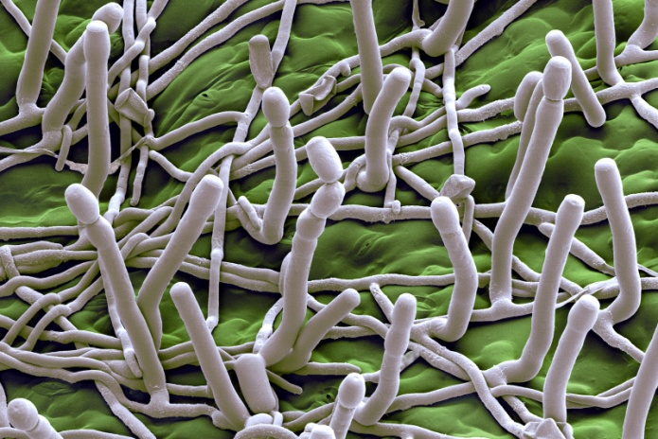
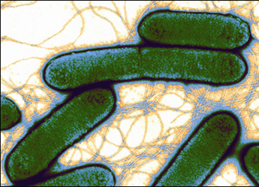
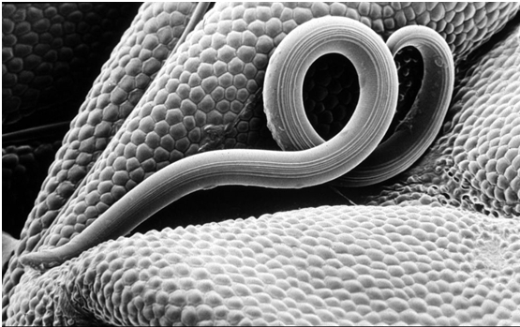
Plant diseases: our focus
Reduction of yield quantity and quality
Economic impact & Threat to global food security
Fungi
Oomycetes
Bacteria
Nematodes

Slide 5
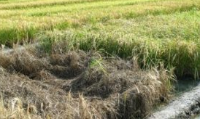
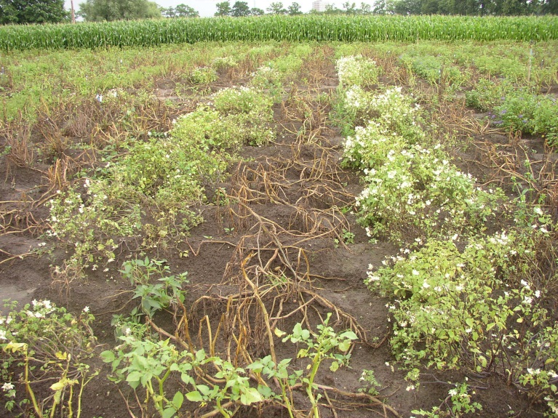
Crops: our focus
Reduction of yield quantity and quality
Economic impact & Threat to global food security
Fungi
Oomycetes
Cereals
Bacteria
Nematodes
Solanaceae

Slide 6
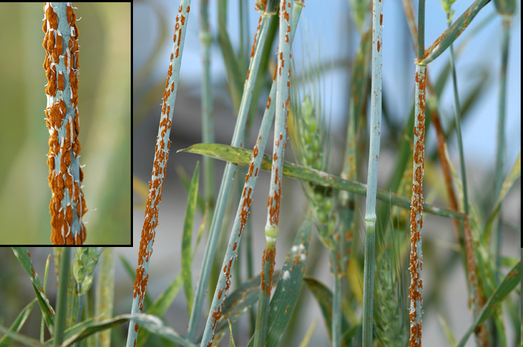
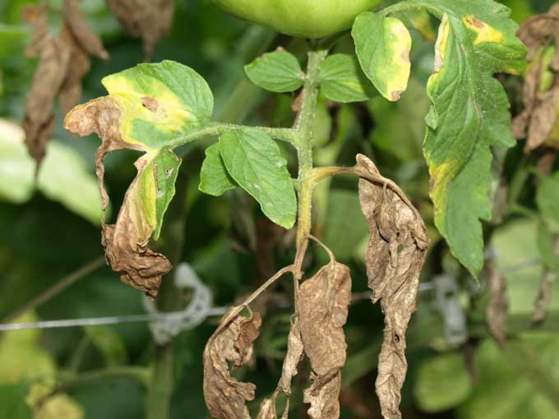
Aim of the COST Action network
Urgent need for:
novel sustainable and broad spectrum resistant varieties of major food crops.
Improved resistance management strategies
Goal: Develop innovative strategies for sustainable broad-spectrum crop resistance
Massive genome sequencing and the advance of effector biology produced tremendous progress in Plant Pathology

Slide 7
Scientific work program and objectives: 4 main work areas
Reflected in the Scientific Program of the first Annual Meeting
WG1: Identification and characterization of effectors
WG2: Host processes and proteins targeted by effectors
WG3: Effector evolution
WG4: Targets for resistance breeding and engineering
Leaders: Bart Thomma (NL) + John Jones (UK)
Leaders: Nemo Peeters (FR) + Hans Thordal-Christensen (DK)
Leaders: Eva Stukenbrock (DE) + Didier Tharreau (FR)
Leaders: Beat Keller (CH) + Vivianne Vleeshouwers (NL)
Core Group: chair/vice-chair/WG leaders/STSM coordinator

Slide 8
The Network Partners
A European Network of Expertise
140 participants from 55 institutions
Breeding
Companies
(11)
University
(22)
Academic research
Institutes (22)
Building on previous and existing European networks of breeders and plant pathologist e.g. BIOEXPLOIT; NEMAGENICS; Effectoromics; PRR-CROP

Slide 9
A European Network of Expertise
24 COST Countries
1 Near Neighbor Country - Ukraine
1 Country with reciprocal agreement - Argentina
Management Committee (MC)
- Two representatives per country
- Nominated by the national COST coordinator
ISRAEL

Slide 10
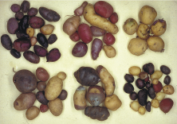
The Network Partners
Bring together multiple disciplines and overcome
fragmentation of research communities and approaches
Rapid advances in
plant pathology
Breeding and engineering for resistance
Breeding
Companies
(11)
University
(22)
Academic research
Institutes
(22)
Massive sequencing of plant and
pathogen genomes
Effector biology

Slide 11
Dissimination and Communication
Communication in the Network
Website – hosted by INRA and developped with EZ-publish
website coordinator N. Peeters (FR)
Communication of the Network
Website
Flyers, Poster
Publications (joint publications between groups of SUSTAIN, acknowledge support by COST grant FA1208!) SCIENTIFIC REPORTING - Beginning 2014
Positioning Paper, Special Issues in Scientific Journals
Conferences, Meetings, Workshops

Slide 12
Instruments and Activities
Short term Scientific Missions (STSM)
Meetings and Conferences
Annual Conference
Smaller meetings/Workshops
Workshops/Sessions in Conferences
Training Schools

Slide 13
STSM
Short term scientific missions (STSMs)
Foster collaborations, learn new techniques, …
5 days to 3 months,
Grant of max 2500 € for exchange between labs form 2 SUSTAIN countries (500€ for travelling + daily allowance, no money for experiments!)
2 calls/year (October/May)
6 STSMs/call
Budget 25 k€/year
STSM Coordinator: Prof. Lieve Gheysen (BE)
STSM Committee for the evaluation of applications:
Chair, Vice-Chair, STSM Coordinator , WG leaders, …
report compulsory! Please acknowledge support by COST grant FA1208!
Applications of early stage researchers will be encouraged!
First call: deadline 11 November,
STSM January to May 2013!

Slide 14
Scientific meetings
Annual Conference (combined with MC meeting)
- ~ 2 ½ days
- MC members (1 or 2 per country depending on MC decision)
- 25-40 additional COST participants (active participants giving e.g. oral presentations, ESRs encouraged)
50-70 k€/ year

Slide 15
Scientific meetings
Annual Conference (combined with MC meeting)
- ~ 2 ½ days
- MC members (1 or 2 per country depending on MC decision)
- 25-40 additional COST participants (active participants giving e.g. oral presentations, ESRs encouraged)
50-70 k€/ year
Smaller Meetings/Dedicated Workshops
- ~ 2 days
15-25 participants
25 k€/workshop

Slide 16
Tools and Activities
Annual Conference (combined with MC meeting)
- ~ 2 ½ days
- MC members (1 or 2 per country depending on MC decision)
- 25-40 additional COST participants (active participants giving e.g. oral presentations, ESRs encouraged)
50-70 k€/ year
Smaller Meetings/Dedicated Workshops
- ~ 2 days
15-25 participants
25 k€/workshop
Sessions or Workshops in Conferences
4-6 invited speakers
5 k€

Slide 17
Training
Training Schools
- 3-15 days
15 – 25 trainees
8 trainers
25 k€/training school
trainees grants
re-imbursement of trainers
local organizer support

Slide 18
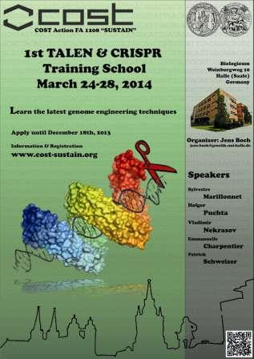
Significant Highlights in Science or Networking
1st TALEN and CRIPR Training School
Dissemination of cutting edge knowledge on novel non-GMO genome editing technologies
18 participants chosen among 38 applications
Presentations by 6 internationally leading experts
Hands-on training by members of Jens Boch’s team, detailed protocols, network of expertise

Slide 19
Training
Training Schools
- 3-15 days
15 – 25 trainees
8 trainers
25 k€/training school
trainees grants
re-imbursement of trainers
local organizer support
First Training School on « Plant Genome Editing with TALENs and CRISPRs»
University of Halle, DE April 2014
organized by Dr. Jens BOCH

Slide 20
Bottom-up approach
}
Meetings and Conferences
Annual Conference
Smaller meetings/Workshops
Workshops/Sessions in Conferences
Training Schools
Initiatives from the WGs (participants)
Proposals discussed by Core Group
Approval by the MC
Local organizer
Eventually combined with other initiatives

Slide 21
Topics for future Small Meetings & Training Schools
-Genomics of effectors (SM or TS)
-Identification of effector genes by analyses of RNAseq data (TS)
-Cellular dynamics of effector action and recognition (SM)
-Functional Analysis of Effectors - transient assays, heterologous systems, molecular and cellular biology (TS,SM) .
-Structure-guided investigation of Effector function and Effector recognition (SM).
-Industry/breeder workshops on pathogen-informed resistance breeding, engineering and monitoring (2xSM).
- ???

Slide 22
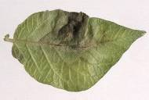
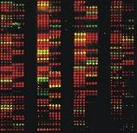
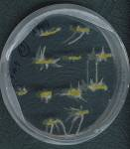
SUSTAIN – A Network of Expertise
Crops
Diseases
Technologies
Fundamental and applied

