Slide 1
Pathogen-informed strategies for sustainable broad-spectrum crop resistance
SUSTAIN
COST Action FA 1208
Chair Thomas Kroj, INRA, Montpellier, France
Co-Chair Aska Goverse, Wageningen University, The Netherlands
Zakopane , 16th of October 2014

Slide 2
Scientific work program and objectives: 4 main work areas
Reflected in the Scientific Program of the Annual Meeting
WG1: Identification and characterization of effectors
WG2: Host processes and proteins targeted by effectors
WG3: Effector evolution
WG4: Targets for resistance breeding and engineering
Leaders: Bart Thomma (NL) + John Jones (UK)
Leaders: Nemo Peeters (FR) + Hans Thordal-Christensen (DK)
Leaders: Eva Stukenbrock (DE) + Didier Tharreau (FR)
Leaders: Beat Keller (CH) + Vivianne Vleeshouwers (NL)
Core Group: chair/vice-chair/WG leaders/STSM coordinator

Slide 3
The Network Partners
A European Network of Expertise
200 participants from 60 institutions
Breeding
Companies
University
Academic research
Institutes
Building on previous and existing European networks of breeders and plant pathologist e.g. BIOEXPLOIT; NEMAGENICS; Effectoromics; PRR-CROP

Slide 4
A European Network of Expertise
24 COST Countries
1 Near Neighbor Country - Ukraine
Management Committee (MC)
- Two representatives per country
- Nominated by the national COST coordinator
ISRAEL

Slide 5
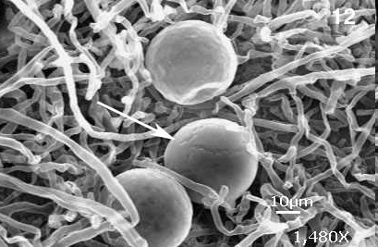
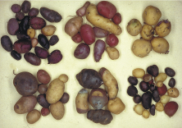
The Network Partners
Bring together multiple disciplines and overcome
fragmentation of research communities and approaches
Rapid advances in
plant pathology
Breeding and engineering for resistance
Breeding
Companies
(11)
University
(22)
Academic research
Institutes
(22)
Massive sequencing of plant and
pathogen genomes
Effector biology

Slide 6
Dissimination and Communication
Communication in the Network
Website – hosted by INRA and developped with EZ-publish
website coordinator N. Peeters (FR)
Communication of the Network
Website
Flyers, Poster
Publications (joint publications between groups of SUSTAIN, acknowledge support by COST grant FA1208!) SCIENTIFIC REPORTING - Beginning 2015
Positioning Paper, Special Issues in Scientific Journals
Conferences, Meetings, Workshops

Slide 7
Instruments and Activities
Short term Scientific Missions (STSM)
Meetings and Conferences
Annual Conference
Smaller meetings/Workshops
Workshops/Sessions in Conferences
Training Schools

Slide 8
Short term scientific missions (STSMs)
5 days to 3 months,
Grant of max 2500 € for exchange between labs form 2 SUSTAIN countries (500€ for travelling + daily allowance, no money for experiments!)
2 calls/year (October/May)
6-8 STSMs/call
Until now 14 STSMs funded
Budget 2013/14 14 k€ for 8 STSM
Budget 16 k€/year
STSM Coordinator: Prof. Lieve Gheysen (BE)
STSM Committee for the evaluation of applications:
Chair, Vice-Chair, STSM Coordinator , WG leaders, …
report compulsory! Please acknowledge support by COST grant FA1208!
Applications of early stage researchers will be encouraged!
4th call: deadline 2 November,
STSM January to May 2014!

Slide 9
Short term scientific missions (STSMs)
Total budget 14 k€

Slide 10
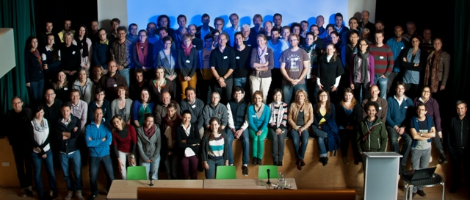
Tools and Activities
Annual Conference (combined with MC meeting)
- ~ 2 ½ days
- MC members (1 or 2 per country depending on MC decision)
- 25-40 additional COST participants (active participants giving e.g. oral presentations, ESRs encouraged)
50-80 k€/ year
2013 Birnam, UK >100 participants
9th-11th October
John Johnes, JHI

Slide 11
Annual Conference
15th – 17th October 2014, Zakopane, Poland
Magda Krzymowska,
Marcin Filipecki
100 participants
30 oral presentations

Slide 12
Tools and Activities
Annual Conference (combined with MC meeting)
- ~ 2 ½ days
- MC members (1 or 2 per country depending on MC decision)
- 25-40 additional COST participants (active participants giving e.g. oral presentations, ESRs encouraged)
50-70 k€/ year
Smaller Meetings/Dedicated Workshops
- ~ 2 days
15-25 participants
25 k€/workshop

Slide 13
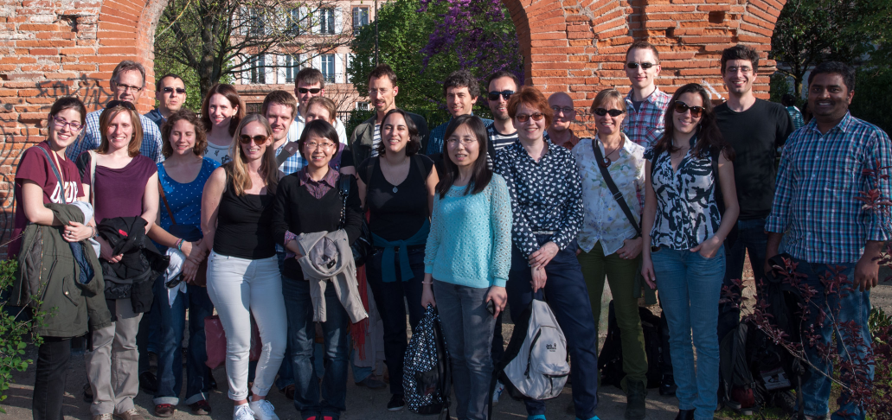
Cellular dynamics of effector action and recognition 9th – 11th April 2014, Toulouse, France
Nemo Peeters, INRA-LIPM
>45 participants
29 oral presentations

Slide 14
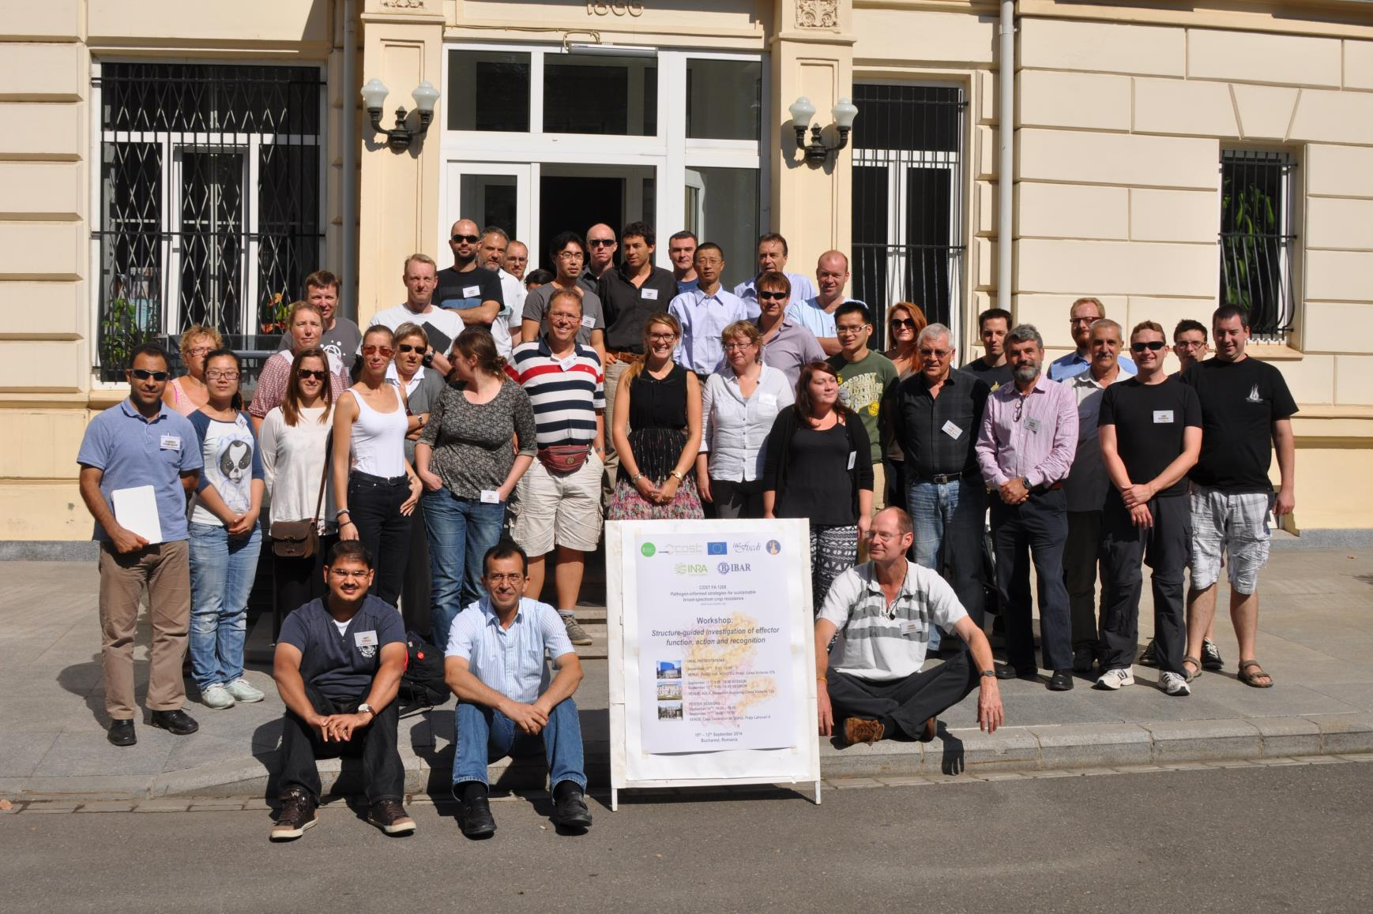
Structure-guided investigation of effector function, action and recognition
10th – 12th September 2014, Bucharest, Romania
Andrei Petrescu, IBAR
50 participants
30 oral presentations

Slide 15
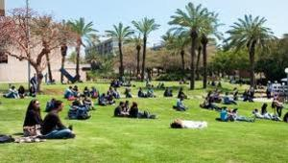
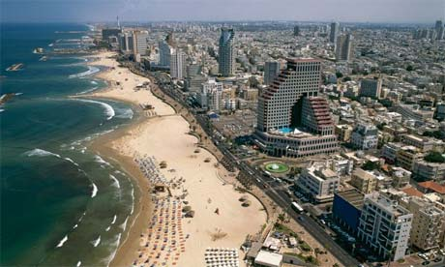
Experimental approaches for the investigation of effector function
10th to the 12th February 2015 in Tel Aviv, Israel.
Guido Sessa, Tel Aviv University
- Protein-protein interaction analysis - PTI/ETI suppression by pathogen effectors - Identification of non-immunity related virulence targets - Innovative strategies to identify effector functions and targets

Slide 16
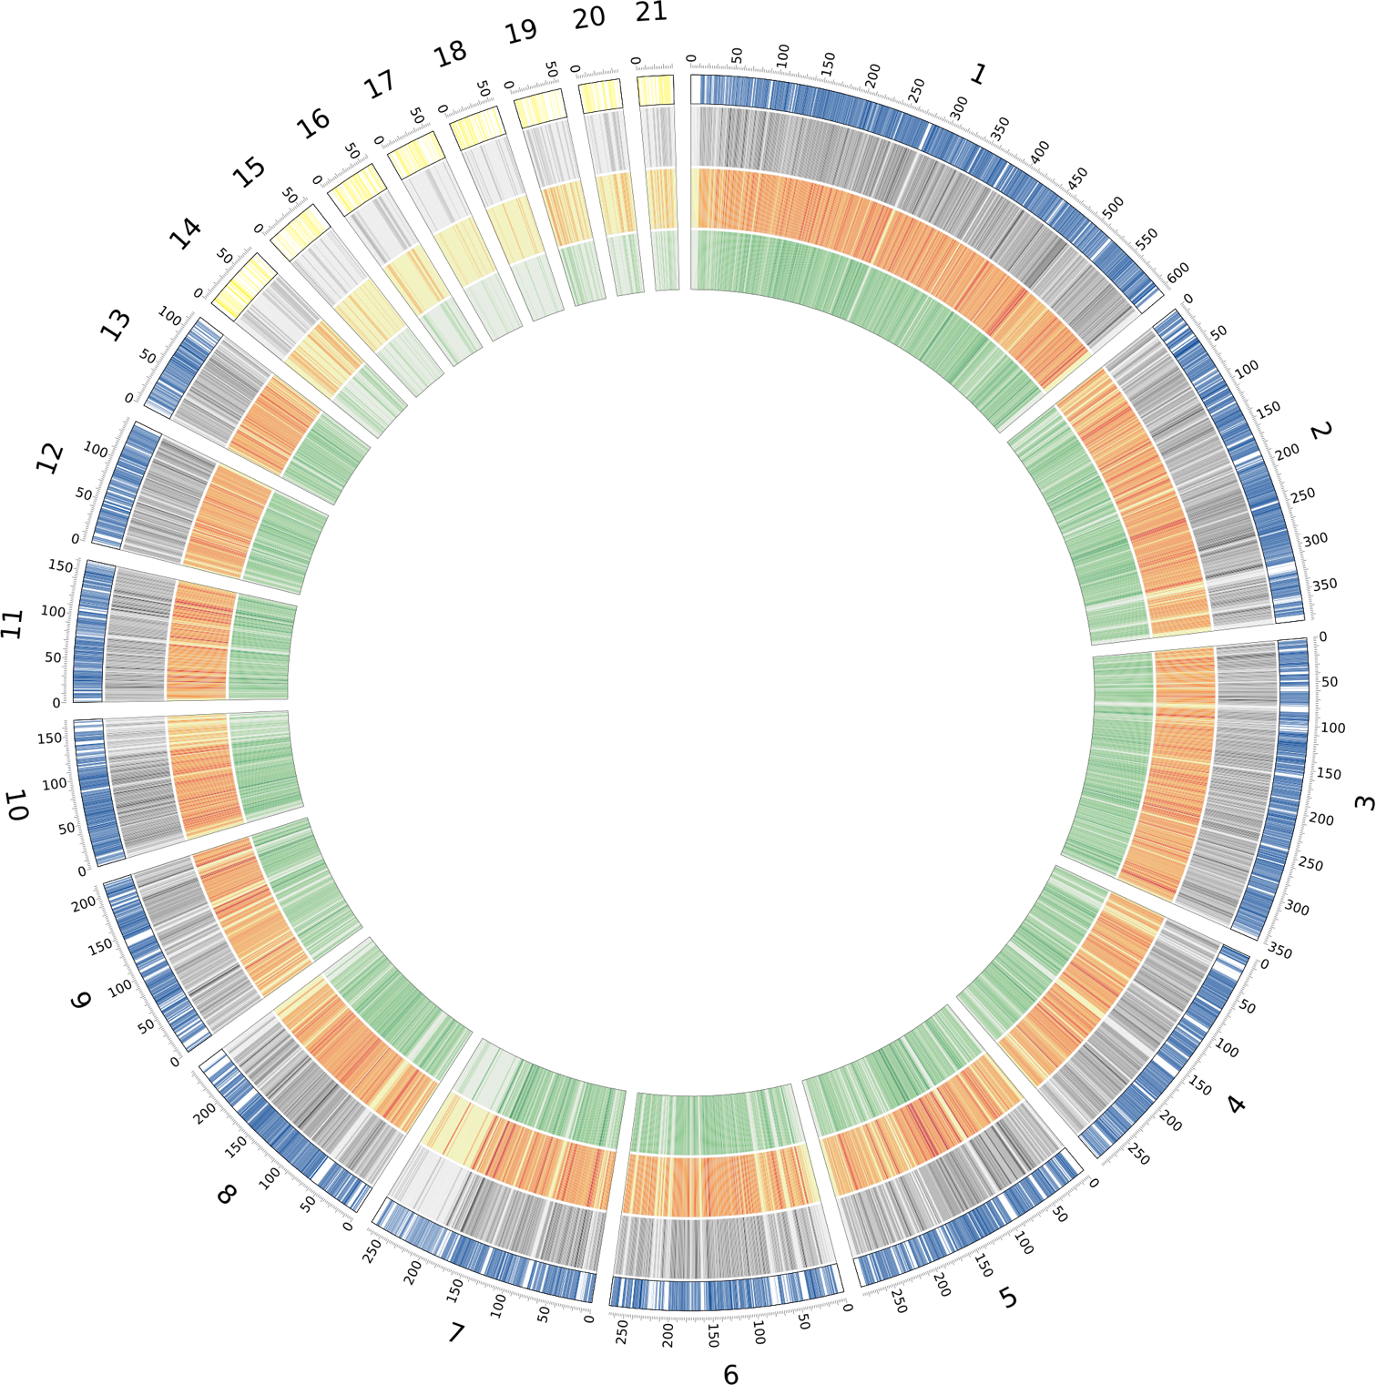
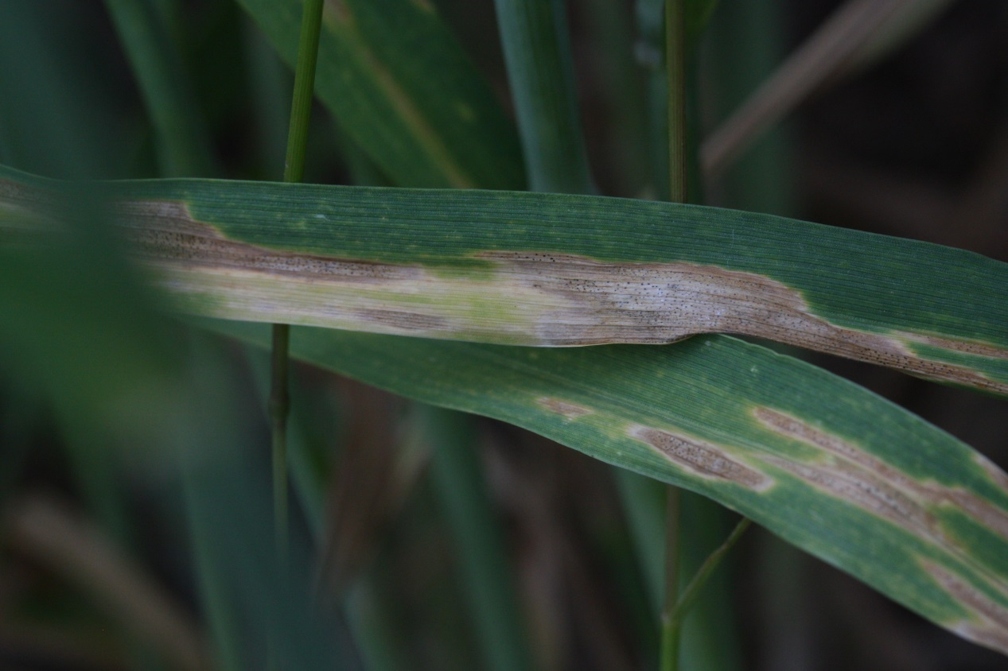
COST SUSTAIN Action FA1208 – Workshop summer 2015
Evolutionary genomics of plant pathogens
Work Group 3 Effector evolution and diversification

Slide 17
Location of workshop – Kiel University, Germany
Host:
Eva H. Stukenbrock
Environmental Genomics
Botanical Institute CAU and
Max Planck Institute for Evolutionary Biology
Travel to Kiel
By train: from all main train stations/airports in Germany
By flight: Via international airport of Hamburg

Slide 18
Evolutionary genomics of plant pathogens
Work Group 3 Effector evolution and diversification
Suggested content:
Session 1: Genomics of plant pathogens, methods and approaches
Session 2: Comparative genomics and characterization of species specific traits
Session 3: Population genomics and analyses of adaptive evolution
Session 4: Two speed genomes and evolution of effector genes
Session 5: Summary and Discussion
Participants
Max 40, including 6-8 invited speakers
Duration
2.5 days

Slide 19
Breeder Workshop April 2015, Wageningen, NL
Aska Goverse Wageningen University
Vivianne Vleeshouvers
Bart Thomma
-Effector-breeding: promises and examples of R gene discovery
-Effector diversity: intraspecific variation, diagnostics and virulence (Avr)
-Common host targets: leads to breed for broad spectrum resistance?
-Host susceptibility: application of S genes to obtain durable resistance?

Slide 20
Tools and Activities
Annual Conference (combined with MC meeting)
- ~ 2 ½ days
- MC members (1 or 2 per country depending on MC decision)
- 25-40 additional COST participants (active participants giving e.g. oral presentations, ESRs encouraged)
50-70 k€/ year
Smaller Meetings/Dedicated Workshops
- ~ 2 days
15-25 participants
25 k€/workshop
Sessions or Workshops in Conferences
4-6 invited speakers
5 k€

Slide 21
Tools and Activities
Training Schools
- 3-15 days
15 – 25 trainees
8 trainers
25 k€/training school
trainees grants
re-imbursement of trainers
local organizer support

Slide 22
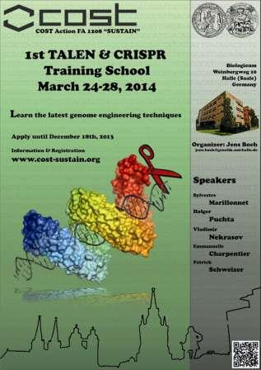
1st TALEN and CRIPR Training School
Jens Boch
Dissemination of cutting edge knowledge on novel non-GMO genome editing technologies
18 participants chosen among 38 applications
Presentations by 6 internationally leading experts
Hands-on training by members of Jens Boch’s team, detailed protocols, network of expertise

Slide 23
Bottom-up approach
}
Meetings and Conferences
Annual Conference
Smaller meetings/Workshops
Workshops/Sessions in Conferences
Training Schools
Initiatives from the WGs (participants)
Proposals discussed by Core Group
Approval by the MC
Local organizer
Eventually combined with other initiatives

Slide 24
Topics for future Small Meetings & Training Schools
-Genomics of effectors (SM or TS)
-Identification of effector genes by analyses of RNAseq data (TS)
-Cellular dynamics of effector action and recognition (SM)
-Functional Analysis of Effectors - transient assays, heterologous systems, molecular and cellular biology (TS,SM) .
-Structure-guided investigation of Effector function and Effector recognition (SM).
-Industry/breeder workshops on pathogen-informed resistance breeding, engineering and monitoring (2xSM).
- ???

Slide 25
Annual Progress Conference (preparation and/or feedback from DC)
COST FA1103: Endophytes in Biotechnology and Agriculture
analysis and utilization of bacterial and fungal endophytes, for plant production and other applications
COST Action FA1306 The quest for tolerant varieties: Phenotyping at plant and cellular level
1. Disseminate the results of high throughput phenotyping (plant & cell) and novel sensor development
2. Integrate results from different omics levels (phenomics, metabolomics, proteomics, transcriptomics, genomics)

Slide 26
Annual Progress Conference (preparation and/or feedback from DC)
COST FA1106 QualityFruit
-Hormone and environmental cues controlling fruit ripening
- Regulatory genes controlling nutritional and sensory fruit traits
FA 1105 Biogreenhouse: Towards a sustainable and productive EU organic greenhouse horticulture
WG1: Robust planting material
WG3: Plant Health

